Slide 1

Deep Learning with Python
Chapter 1-2
Book Reading Group
Åke Edlund, Daniel Edsgärd

Slide 2
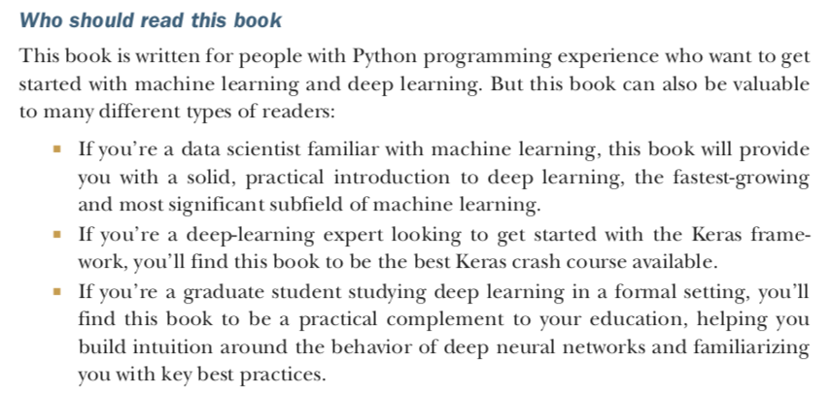
Technical focussed book – for developers

Slide 3
Goal with this reading group is to
1. Make sure we do read the book (easier with some pressure/encouragement)
2. Make sure we read the book in detail
3. Don’t get stuck on things you don’t understand – solve it together
4. Share know-how and experiences – plenty of ML/DL experience within Telia
5. Learning by doing – test out the book’s github.
Community driven learning in focus
We don’t have the manpower to:
Answer emails – use chat on MS Teams (often you’ll get help from other colleagues there)
Debug code – again, use chat and feel free to upload docs to the MS Teams
We will:
Collect questions from the MS Teams to highlight during our weekly sessions
Handle the November ’exams’ for anyone interested

Slide 4
Practicals* (1/2)
*We’re testing this for the first time, so we’ll adapt to feedback during course
- Read the chapter(s) as planned
- Do write questions into the common document on MS Teams
This is imporant for the planning of the next session
Optional (gold star): write answers (ideally) before sessions
– on anyone’s questions
- Do help each other on MS Teams (and elsewhere, of course)
Answer chat, upload findings, write helpful guidings
- Team up with colleagues to discuss the book and code
Always best to do this in person. Ideally meet up on regular basis, some day’s before the weekly meeting on Thursdays.
By Tuesdays
EOB**
**Part of passing the reading group

Slide 5
Practicals* (2/2)
*We’re testing this for the first time, so we’ll adapt to feedback during course
There will be a reviewed practical project & theory assignment in November (for these who want to have a ’certificate’ that they passed the course).
Maybe, depending on budget, we should meet up in Q1 2019 – would be cool with a DL hackathon.
A more theoretical book, Deep Learning by Goodfellow et al, is planned for in 2019
How to pass the reading group
80% contribution of questions to meetings (starting week 38)
– make sure to add your name when adding text in the ’ Questions to the chapters.ppt’
2) Pass the practical & theory assigment in November

Slide 6
Session outline – 60 min
Quick summary of the week’s reading, 1-2 slides (5-10 min)
Group discussions (5 persons per group) (20 min)
Discussing this week’s reading
Addressing N number of questions (assigned to the group)
Write your answers directly into the MS Teams Forms
Group presentations of answer slides (~5min/group)
Open discussion, all to particicpate
Summary, wrap up, next session (5 min)
Note: after session, we will update the wiki and files with above input.

Slide 7
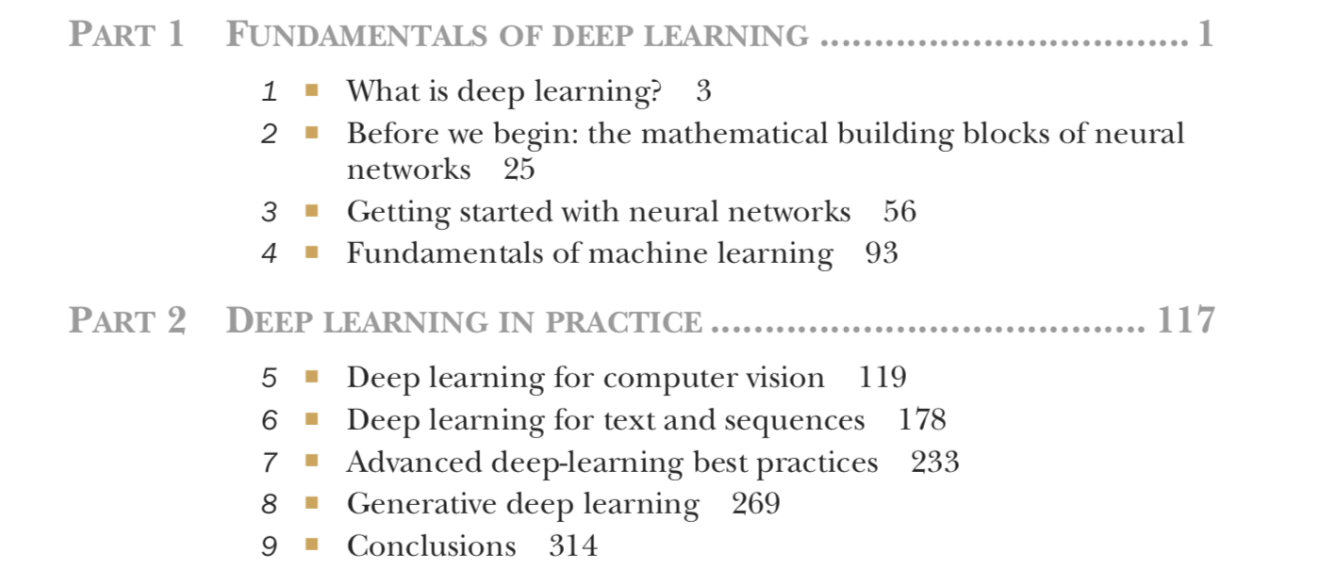
Timeplan
Sep 13 - Chapter 1-2
Sep 20 - Chapter 3
Sep 27 - Chapter 4
Oct 4 - Chapter 5.1-5.2
Oct 11 - Chapter 5.3-5.5
Oct 18 - Chapter 6.1-6.2
Oct 25 - Chapter 6.3-6.5
Nov 1 - Chapter 7
Nov 8 - Chapter 8.1-8.3
Nov 15 - Chapter 8.4-8.6
Nov 22 - Chapter 9

Slide 8
Recap
Read the book
Add your questions (on Tuesdays before EOB)
Talk to your colleagues
Meetings on Thursday
Exam in November (not mandatory)

Slide 9
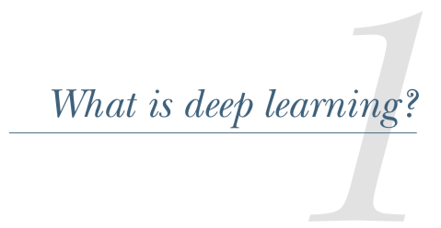


Slide 10

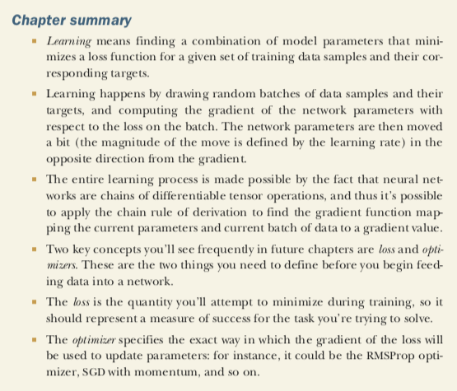



Slide 11
Discussing the questions, wrap up

